Slide 1

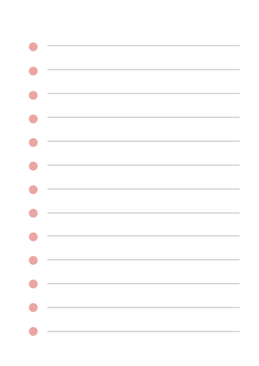




UNSUPERVISED LEARNING
Presented by PinPin

Slide 2



BACKGROUND INFO
The Education System is flawed. Every student is different.
Such as learning and communicating.
In order to effectively address the diverse needs of our student body, we implement an unsupervised clustering AI that categorizes students into multiple groups based on their unique characteristics, learning styles, and academic requirements.

Slide 3





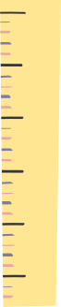

TABLE OF CONTENTS
Dataset Exploration
Dataset Processing
Model Selection
Model Improvement

Slide 4


DATASET EXPLORATION

Slide 5


DATA DICTIONARY
Name | Data Type | Description
Student_ID | Numeric | Primary-key of each student
Gender | Categorical | Student's Specified Gender
Age | Numeric | Student's Age
English_Score | Numeric | Marks of the English Exam
Math_Score | Numeric | Marks of the Math Exam
Science_Score | Numeric | Marks of the Science Exam

Slide 6
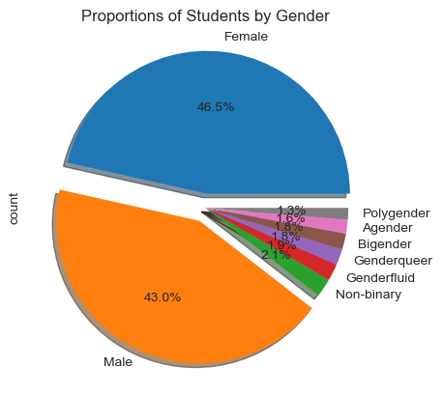
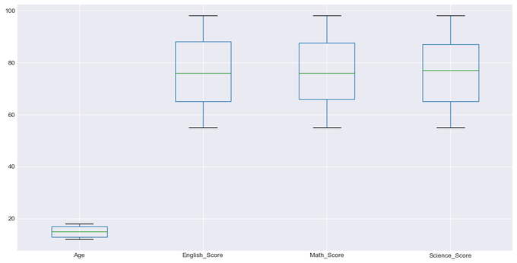
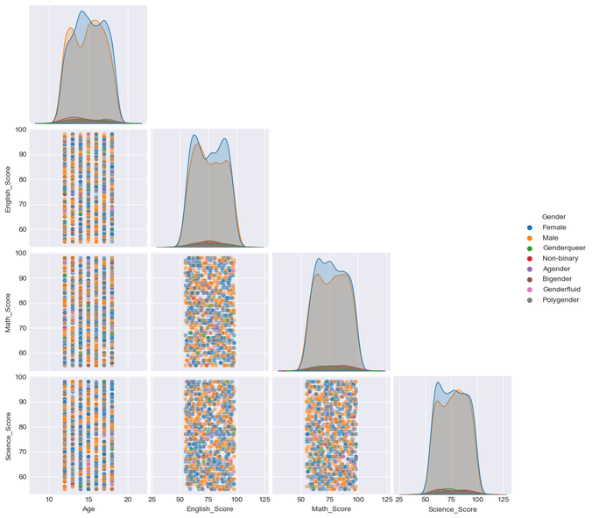
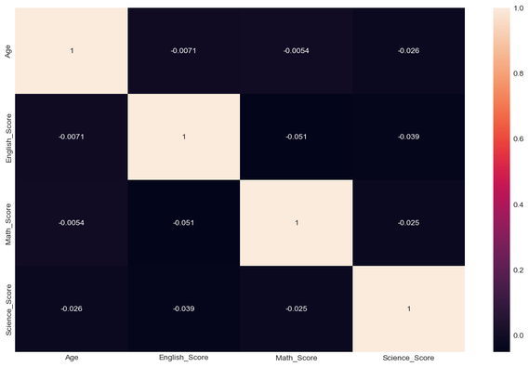
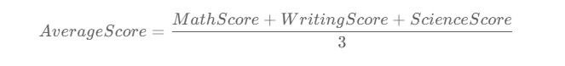
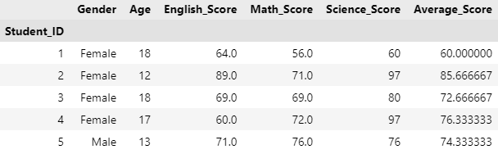
GRAPHS
Data Information
FUNCTIONS USED
df.shape
df.info()
df.describe()
df.isna().sum()
In our Dataset, we have:
6 Features
Shape = (1000, 6)
categories with NA values are
Math_score
English_score
Feature Engineer

Slide 7
DATASET PROCESSING

Slide 8
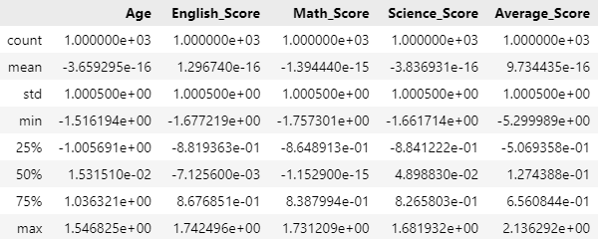
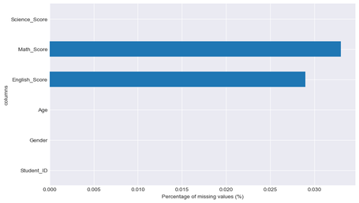
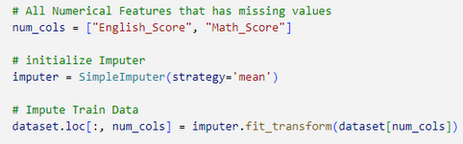


SCALING DATA
MISSING DATA
Increasing | Decreasing values
NA values
Methods
Standardization
the mean and divide by variance
features centered to 0 & variance = 1
Normalization
data ranges from -1 to +1
How to Handle:
drop df.dropna(subset=)
Imputation - replace with educated guesses
SimpleImputer: mean | median | mode
IterativeImputer: creates Regression model to guess
KNNImputer: take nearest features thats not NA
Note:
Since there is little correlation with the features,
IterativeImputer or KNNImputer is Useless.

Slide 9
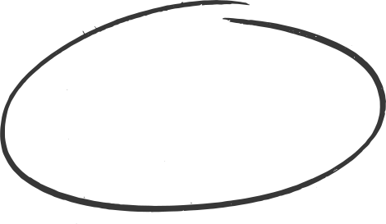
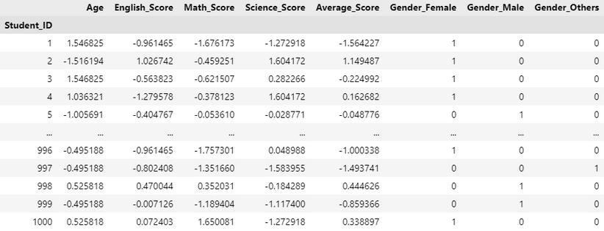
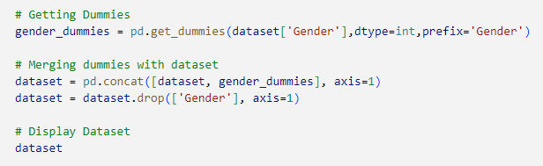
ORDINAL ENCODING
the Transformation of discrete
(binary or multinominal) variables to Numeric.
😲
Categorical Data
Gender
[ Agender | Bigender | Female | Genderfluid] [ Genderqueer | Male | Non-binary | Polygender]
Since we don’t have Dichotomous Variables (Binary), it will be better to use One-Hot Encoding.

Slide 10
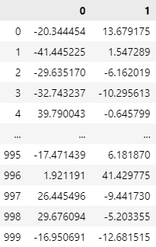
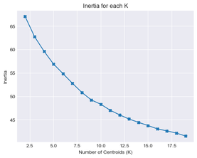
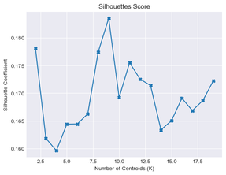
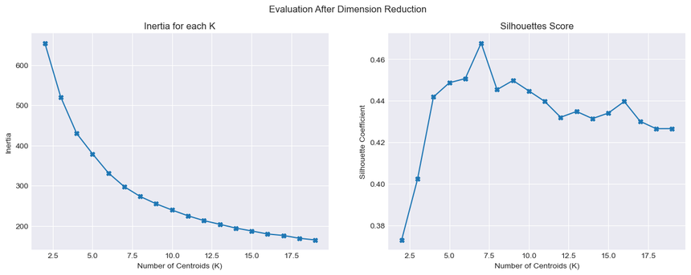
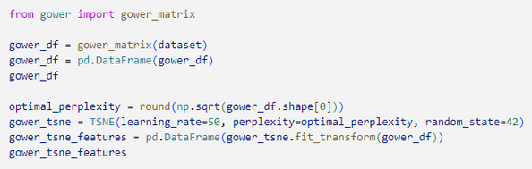
DIMENSION REDUCTION
Transformation of data from a high-dimensional space to low-dimensional space
😲
Techniques:
(Non-Linear) t-Distributed Stochastic Neighbor Embedding (TSNE)
(Linear) Principal Component Analysis (PCA)
TSNE:
Great for finding clusters and patterns in complex data, especially when they are not separable by a linear boundary.
Before
After

Slide 11
MODEL SELECTION

Slide 12
SCORING METHODS
SILHOUETTE
SCORE
DAVIES-BOULDIN
SCORE
CALINSKI-HARABASZ SCORE
The silhouette coefficient is a measure of how similar a data point is within-cluster compared to other clusters
Higher = Better Fit
Ratio between the within cluster distances and the between cluster distances and computing the average overall the clusters
Bounded –> 0 to 1
Lower = Better Fit
Ratio of the sum of between-clusters dispersion and of inter-cluster dispersion for all clusters
Higher = Better Fit

Slide 13
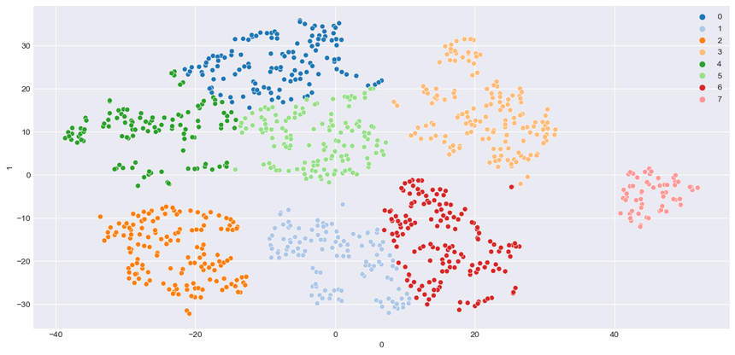
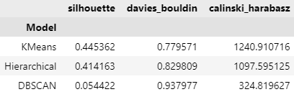
MODEL BUILDING
Models
Best K-Clusters = 6
K-Means Clustering (Centroid-based)
Agglomerative Clustering (Hierarchical-based)
DBScan Clustering (Density-based)
Results

Slide 14
MODEL IMPROVEMENT

Slide 15

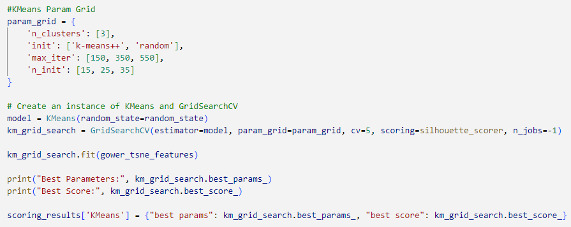
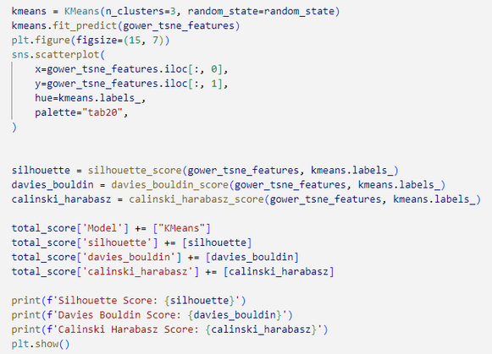
MODEL EVALUATION
KMeans
Results
Method of vector quantization, originally from signal processing, that aims to partition n observations into k clusters in which each observation belongs to the cluster with the nearest mean
Best Parameters:
init = k-means++
max_iter = 150
n_clusters = 7
n_init = 25
Silhouette Score:
0.4648

Slide 16
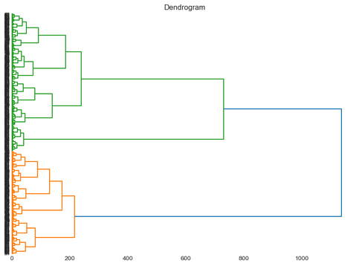
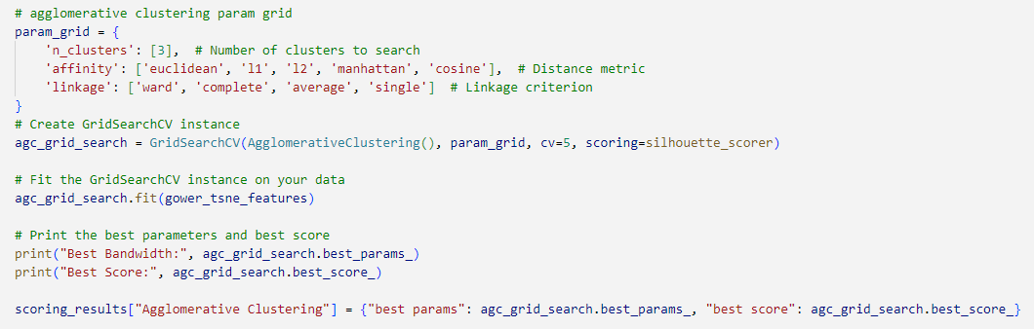
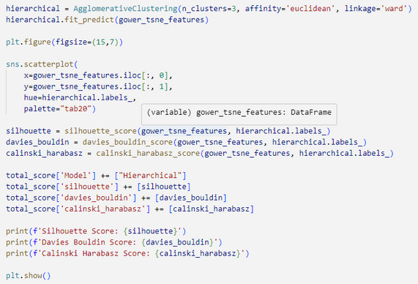
MODEL EVALUATION
Hierarchical Clustering
Results
Separates data into groups based on some measure of similarity, finding a way to measure how they're alike and different, and further narrowing down the data. Good for Anomaly Detection!
Best Parameters:
affinity = euclidean
linkage = average
n_clusters = 7
Silhouette Score:
0.4483

Slide 17
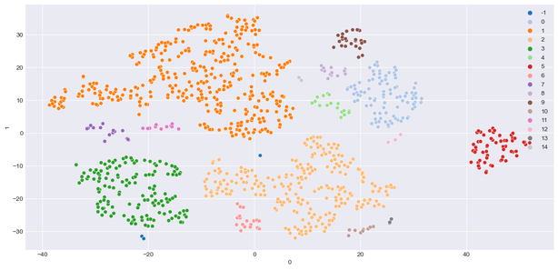
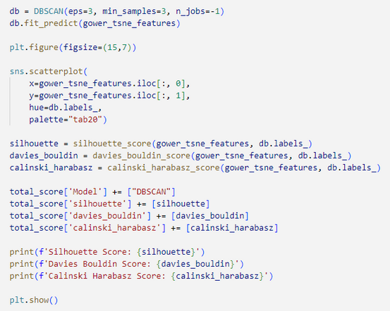
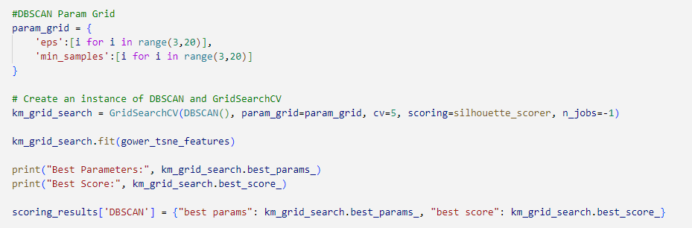
MODEL EVALUATION
DBSCAN
Results
Algorithm for density-based clustering. It can discover clusters of different shapes and sizes from a large amount of data, which is containing noise and outliers. Since our Clusters are distinct, there’s no point of DBSCAN.
Best Parameters:
eps: 9
min_samples: 12
Silhouette Score:
0.3457

Slide 18
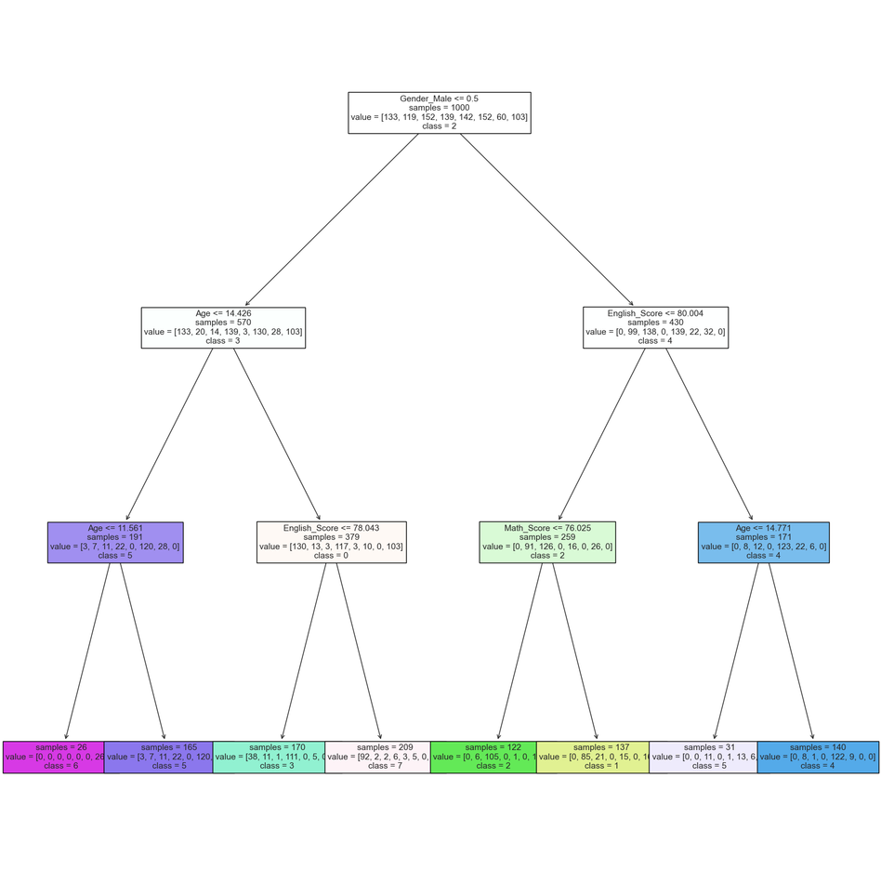
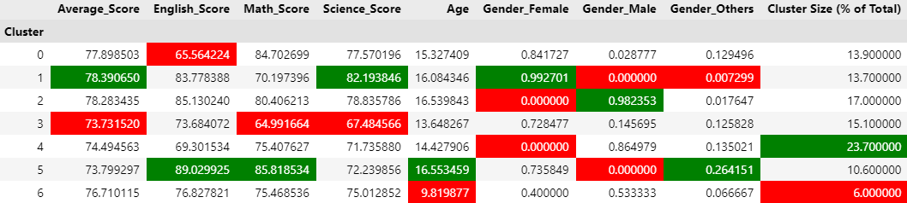
CONCLUSION
Clusters
There is total of 7 clusters
Youngest Cluster = 6
Oldest Cluster = 5
Cluster 3 needs more attention
Worst Overall in Math & Science
Consist of Majority 13 year old Females

Slide 19
THANK YOU

